Slide 1
Authentication using Jason web token

Slide 2
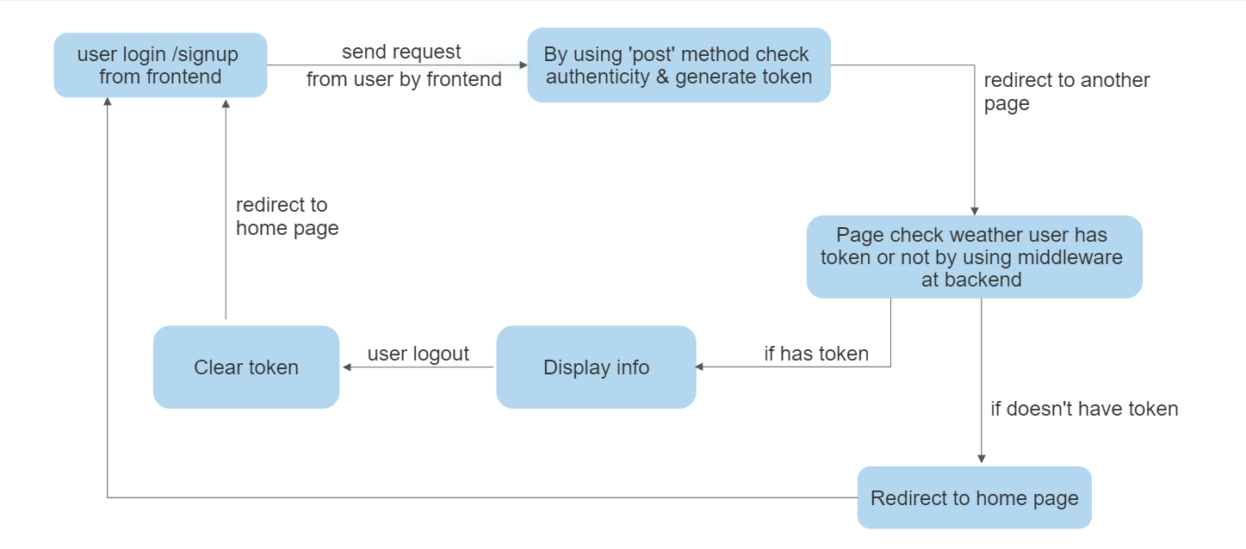

Slide 3
First of all we need to create react app npx create-react-app "App_name“
We need to install some kind of packages by using these commands :
npm i react-router-dom
npm i react-alert
After that we need to add one line of code in
package.json file of app above "dependencies" like this:
"proxy": "http://localhost:3000/",
After that we can run our app by using this command :
npm run start

Slide 4
Now For backend part we need to create one folder inside our appInside
that folder we need to install express, mongoose by these commands :
npm install express
npm install mongoose
command will generate package.json file
npm init –y
After that we need to install some packages by using these commands:
npm install bcryptjs
npm install cookie-parser
npm install dotenv
npm install jsonwebtoken

Slide 5
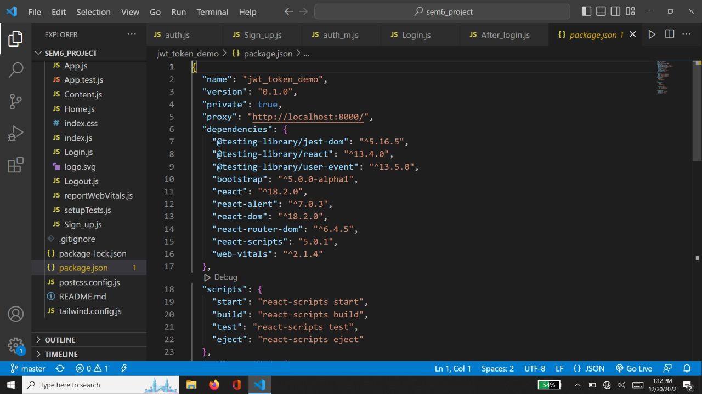

Slide 6
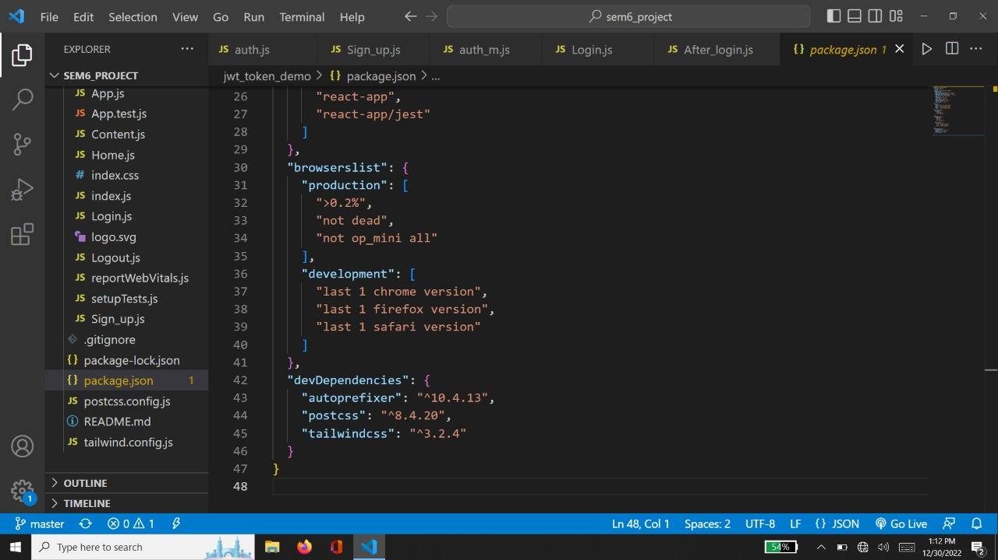

Slide 7
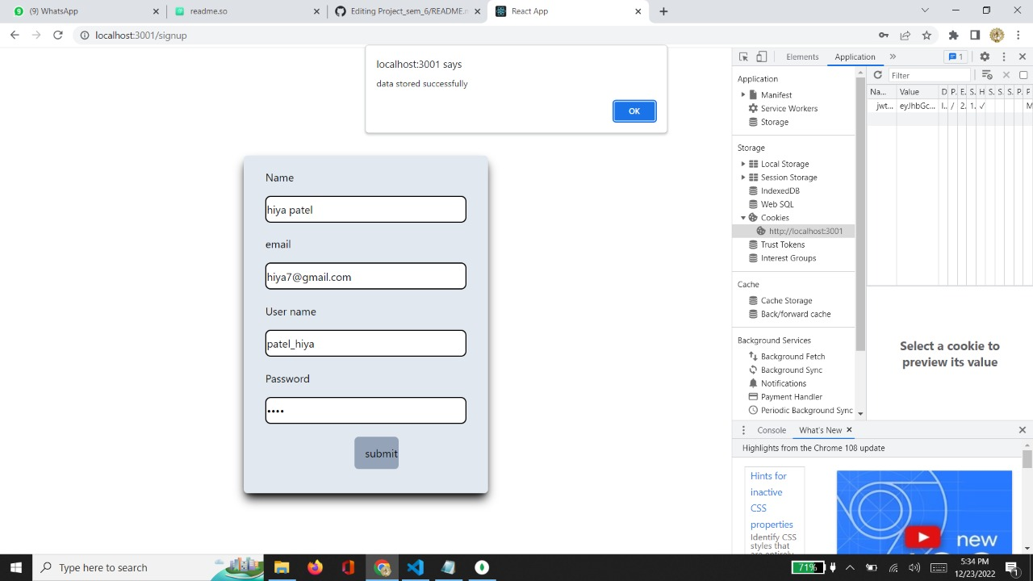

Slide 8
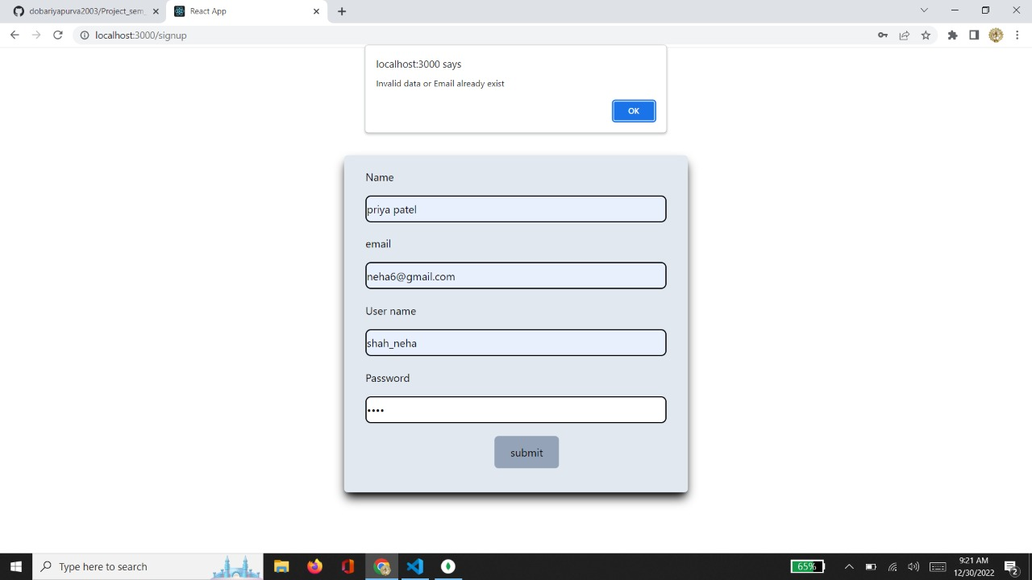

Slide 9
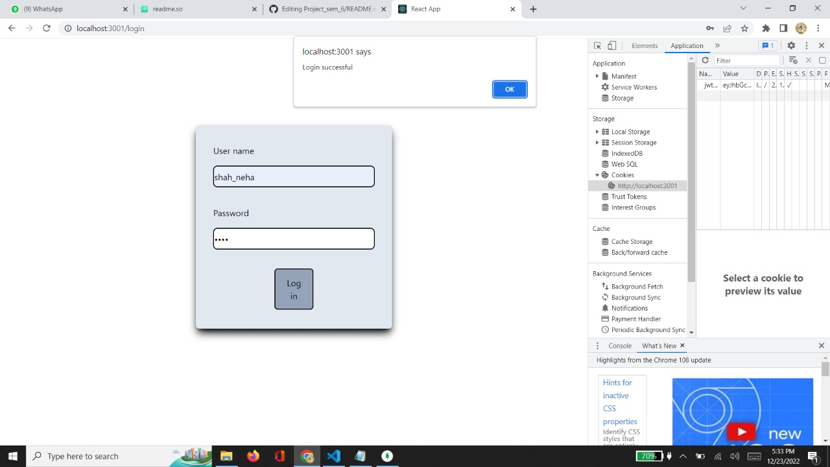

Slide 10
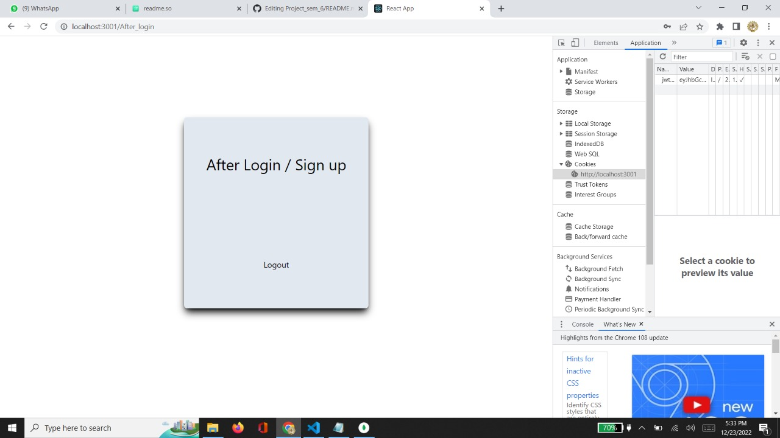

Slide 11
At backend part by using ‘post’ method we authenticate weather user has correct username and password or not.
If user has correct username and password we generate a token.
That token is add in cookie by using inbuilt function
Cookie(“name of token”,token,{
expires(time),httponly:true
})

Slide 12
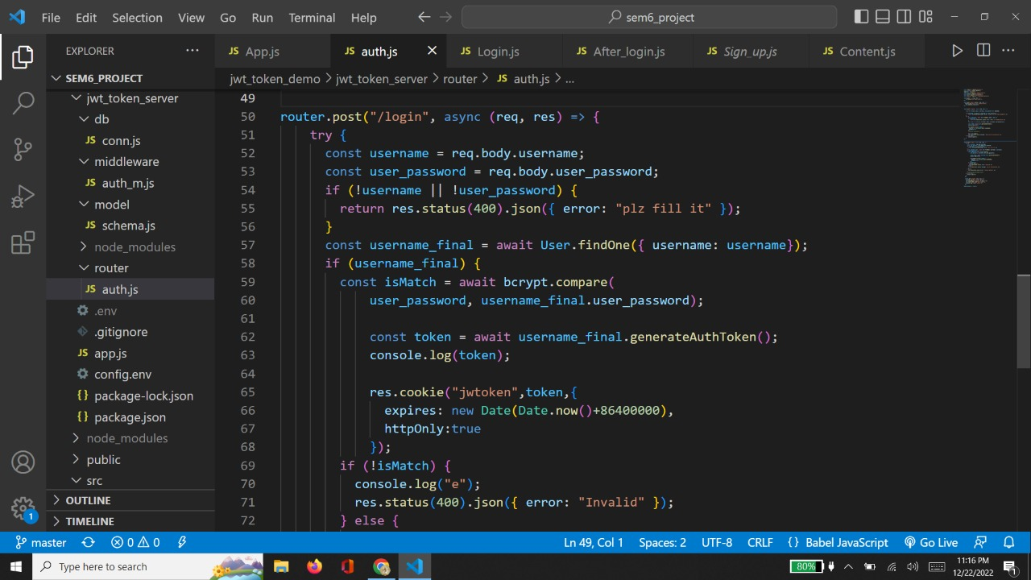

Slide 13
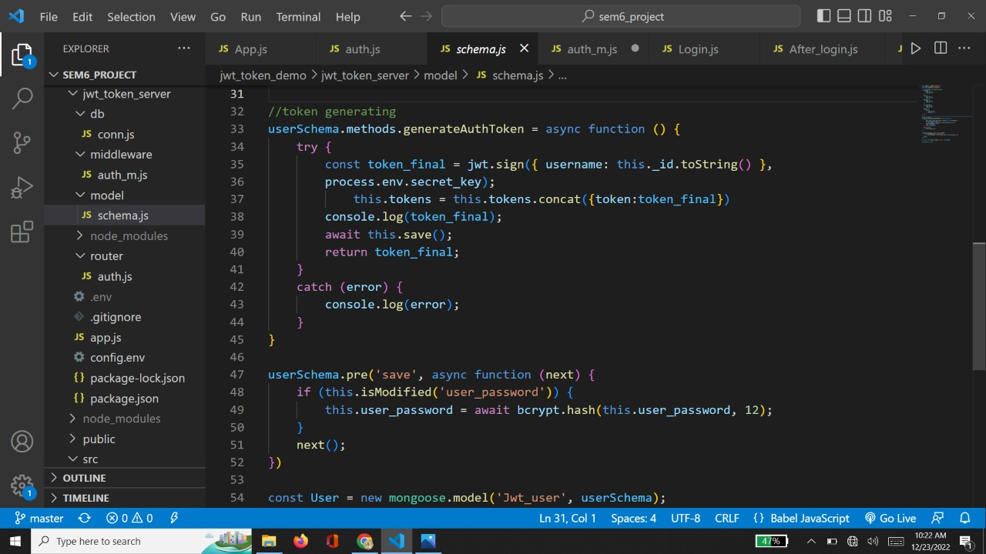

Slide 14
As we use post method for login in same manner we used for ‘sign up’.
Here we added one constraint that if user has already signed up once with particular email id that email id can’t be used to again sign up.
Here also we generated a token & stored it in ‘cookie’.

Slide 15
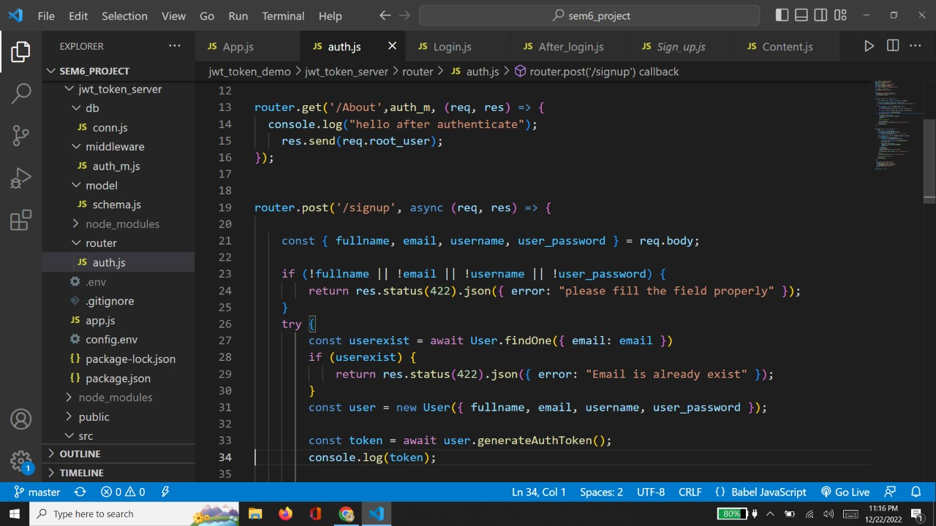

Slide 16
Now for verifying weather user is having token or not we added middleware by using ‘get’ method.
That middleware function verifies weather user has token or not by getting data from database where the token is stored.

Slide 17
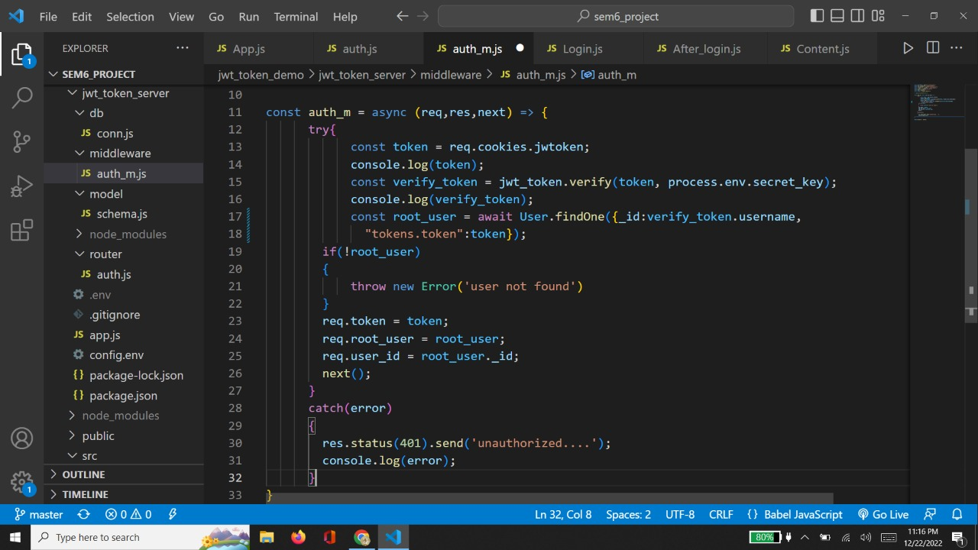

Slide 18
Here is the page which should display after authentication.
By this page user can logout.
We send request for logout by ‘get’ method at backend.
At backened if user has logout ,system will clear the token which was stored in cookie by using inbuilt function
clearCookie(“tokenname ”,{path:”/”});

Slide 19
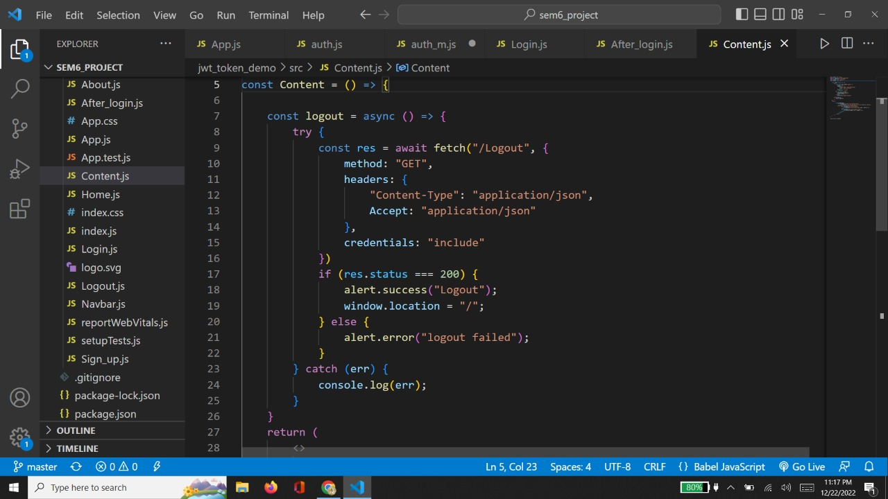

Slide 20
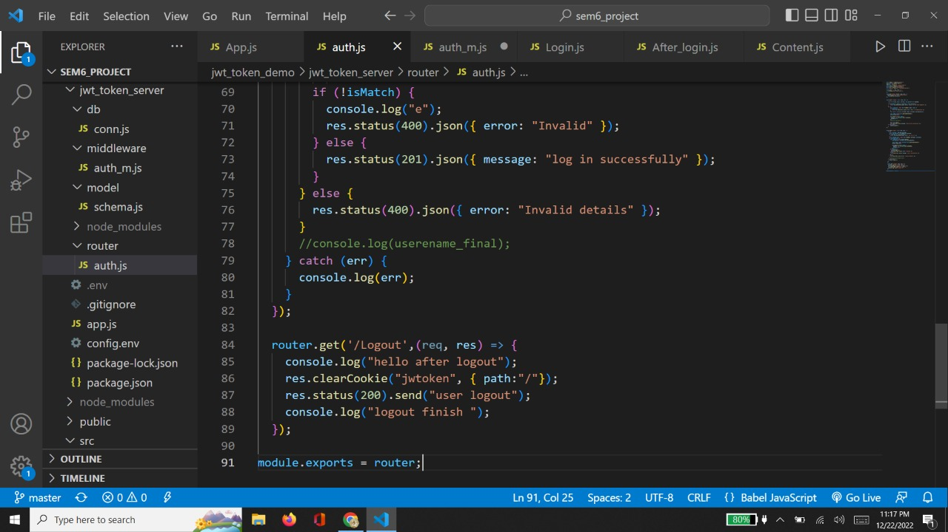

Slide 21
You can use this link to access playlist or usefull videos for mern development :
https://youtube.com/playlist?list=PLwGdqUZWnOp3t3qT7pvAznwUDzKbhEcCc

